Slide 1

Classifying the Circuit De-obfuscation Runtime based on Learning Methods and K-means Clustering
Eighth Presentation

Slide 2
Step 4: Training, validating, and testing the CNF-Net model

Slide 3
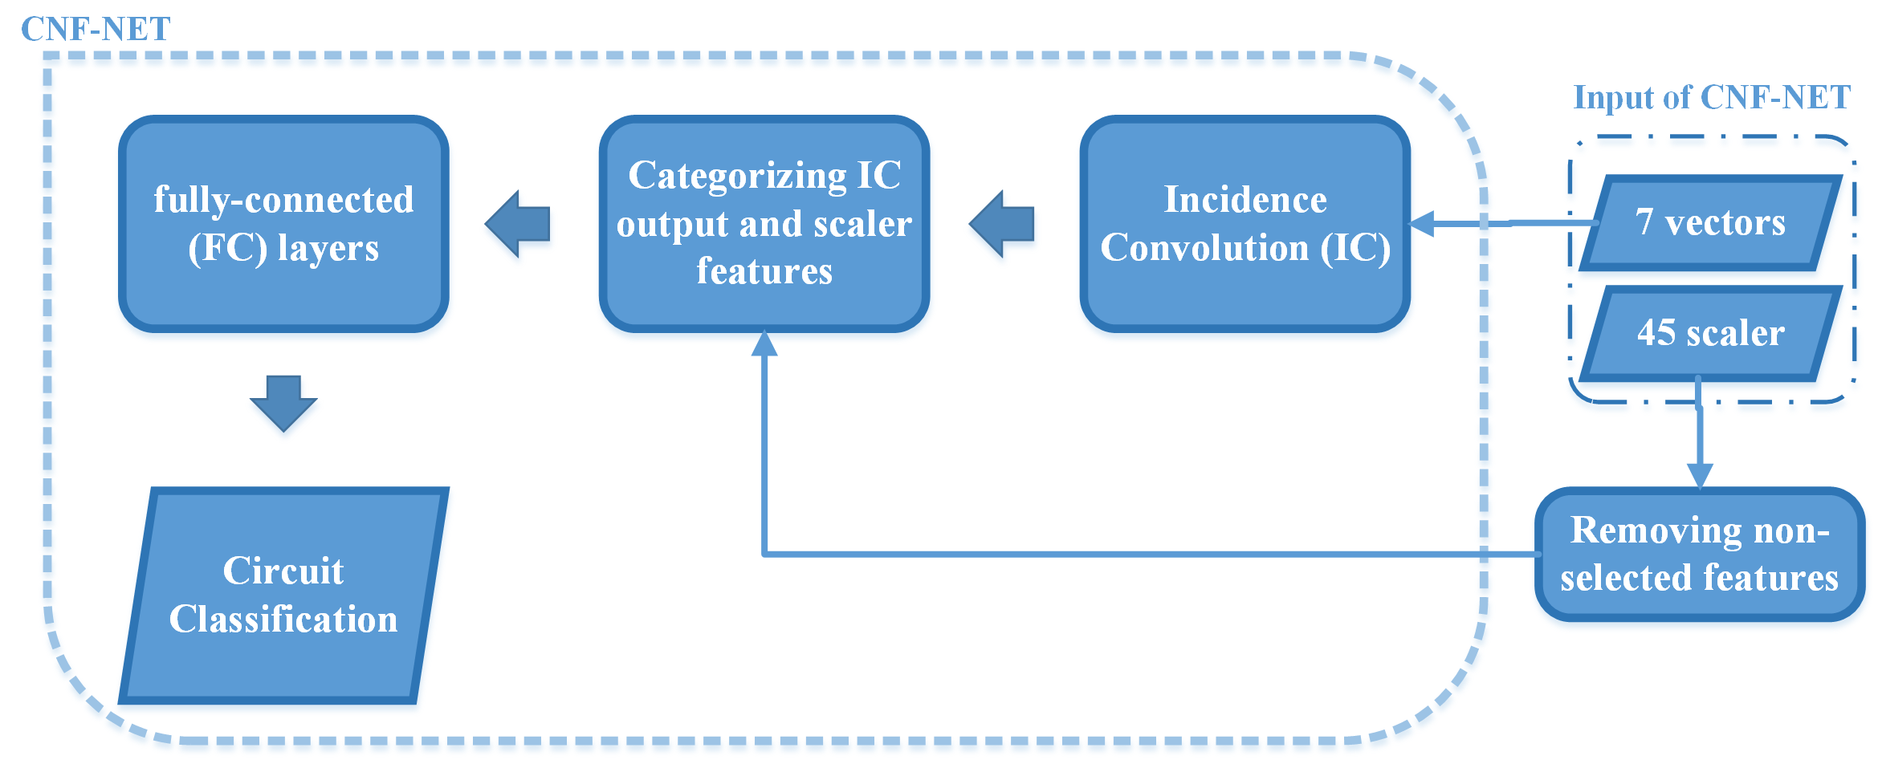
The blockdiagram of the CNF-NET

Slide 4
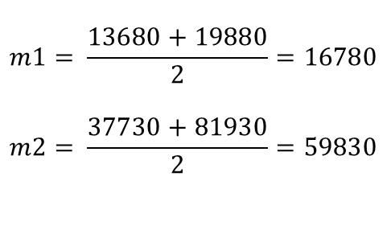
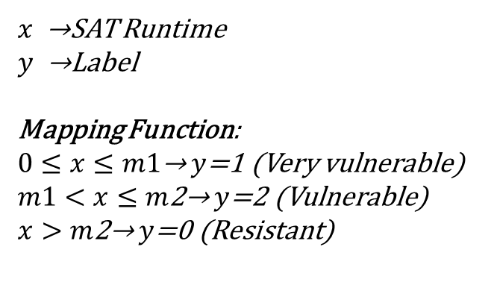
3 class distribution of circuit classification
$$m1= \frac{13680+19880}{2}=16780$$
$$m2= \frac{37730+81930}{2}=59830$$
#Very vulnerable samples = 426
#Vulnerable samples = 5
#Resistant samples = 55
$x$ →SAT Runtime
$y$ →Label
Mapping Function:
$0≤x≤m1\text{→}$ $y$=1 (Very vulnerable)
$m1<x≤m\text{2}\text{→}$ $y$=2 (Vulnerable)
$x>m\text{2}\text{→}$ $y$=0 (Resistant)

Slide 5
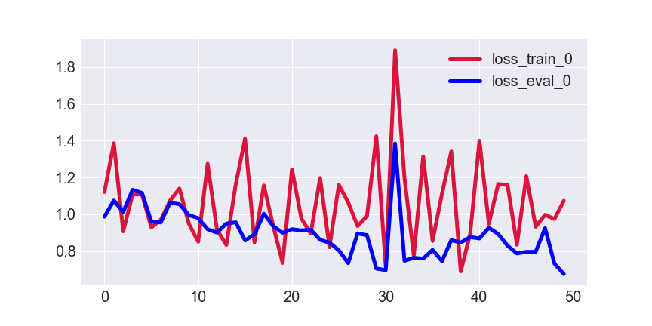
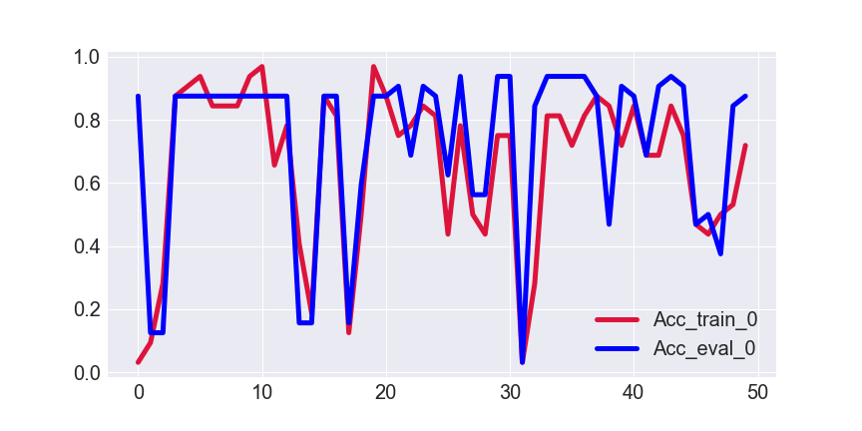
Training and validating the CNF-Net model for 3 class classification
loss
Accuracy
Epoch
Epoch

Slide 6
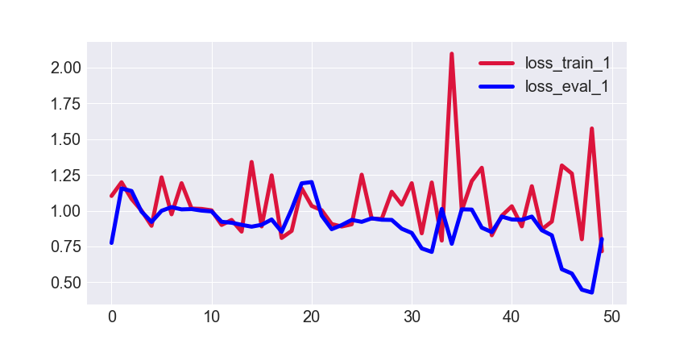
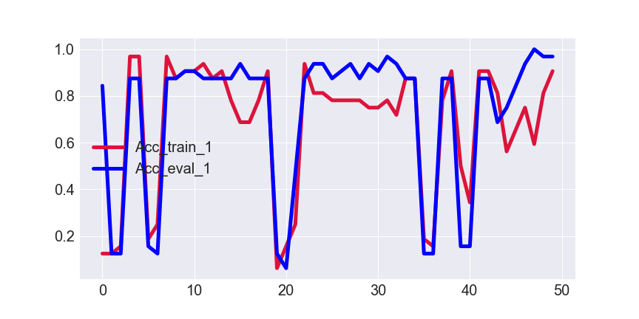
Training and validating the CNF-Net model for 3 class classification
loss
Accuracy
Epoch
Epoch

Slide 7
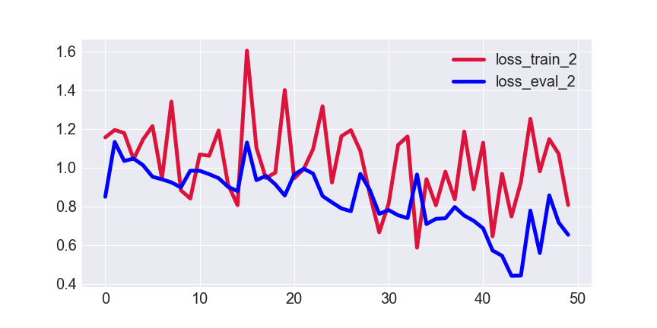
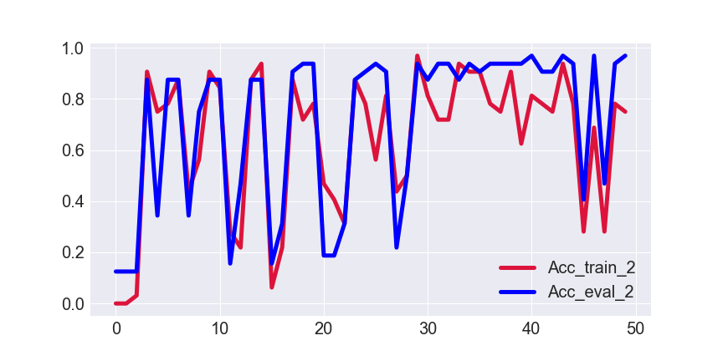
Training and validating the CNF-Net model for 3 class classification
Accuracy
loss
Epoch
Epoch

Slide 8
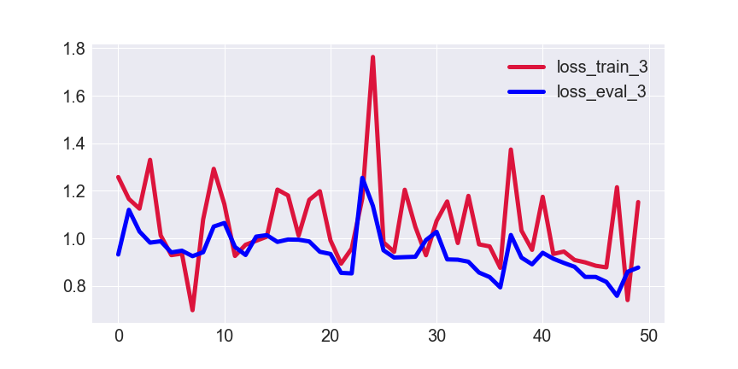
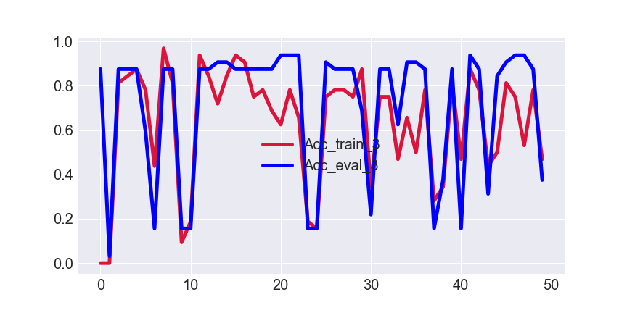
Training and validating the CNF-Net model for 3 class classification
Accuracy
loss
Epoch
Epoch

Slide 9
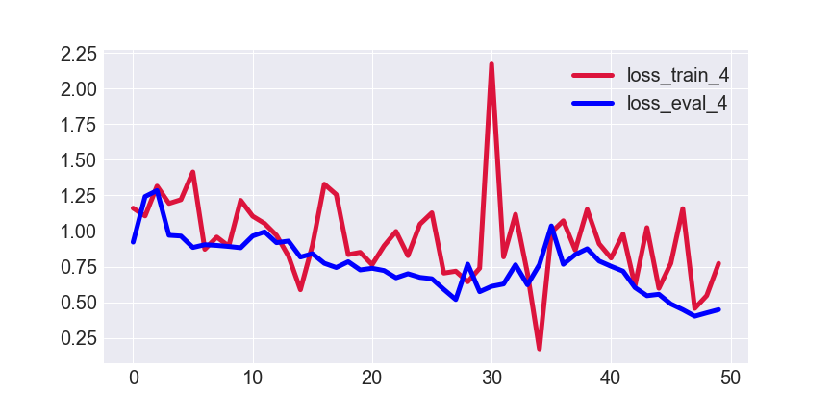
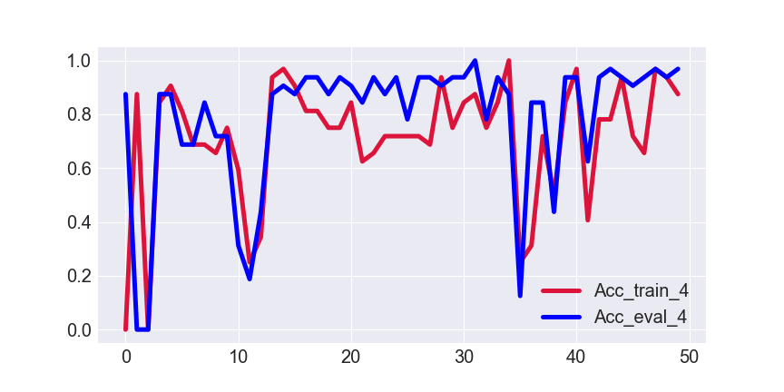
Training and validating the CNF-Net model for 3 class classification
Accuracy
loss
Epoch
Epoch

Slide 10
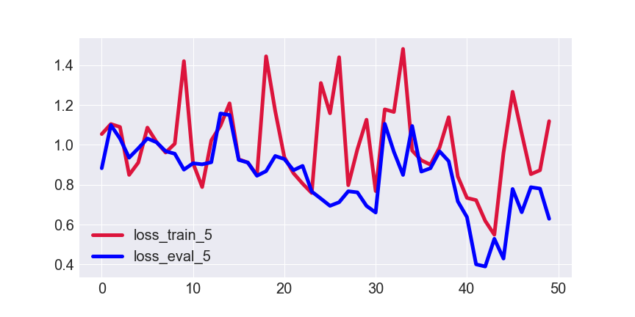
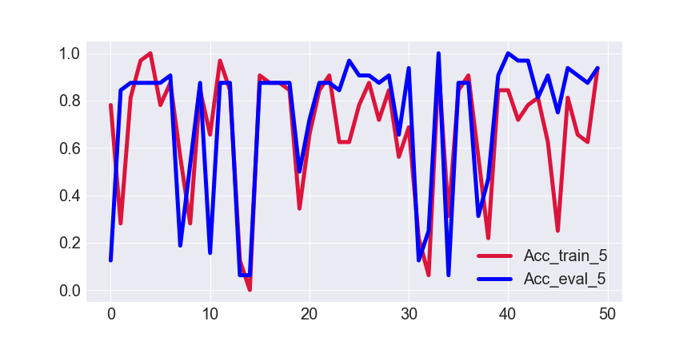
Training and validating the CNF-Net model for 3 class classification
Accuracy
loss
Epoch
Epoch

Slide 11
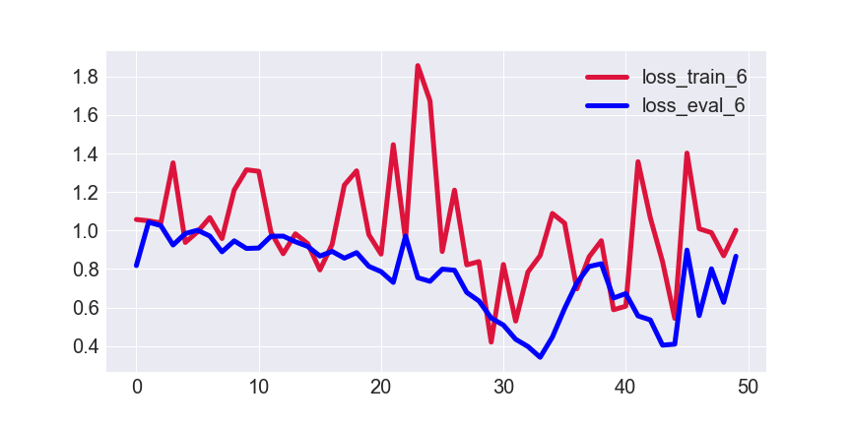
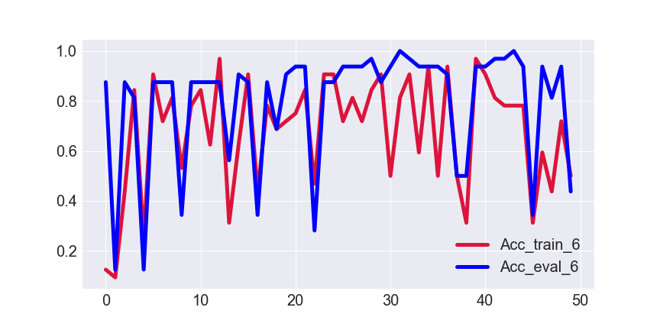
Training and validating the CNF-Net model for 3 class classification
Accuracy
loss
Epoch
Epoch

Slide 12
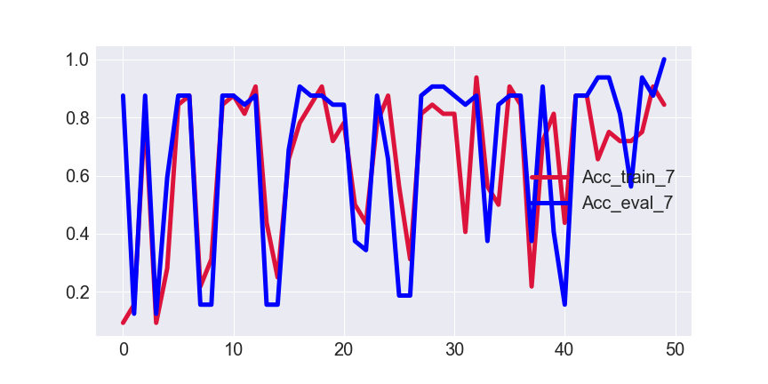
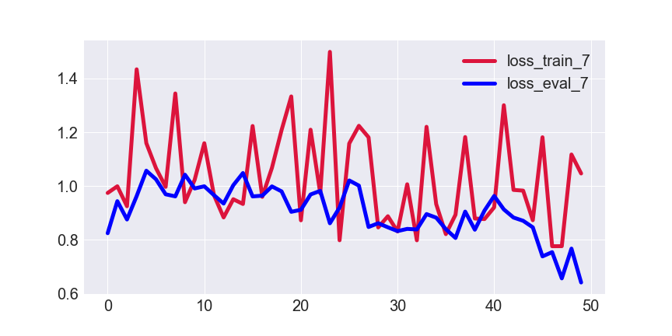
Training and validating the CNF-Net model for 3 class classification
Accuracy
loss
Epoch
Epoch

Slide 13
Testing the CNF-Net model for 3 class classification
K | Accuracy
1 | 0.6875
2 | 0.7500
3 | 0.8125
4 | 0.5000
5 | 0.7500
6 | 0.9375
7 | 0.6563
8 | 0.6563
Mean of Accuracy results → 0.7188
Std of Accuracy results → 0.1283

Slide 14
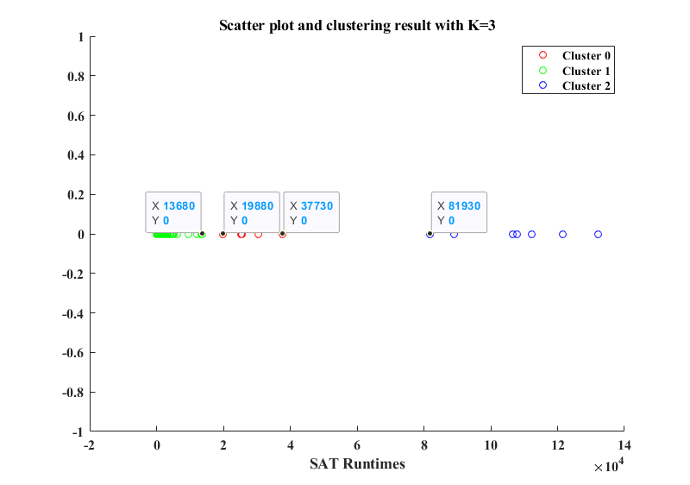

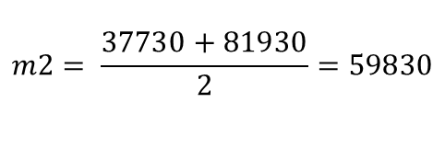
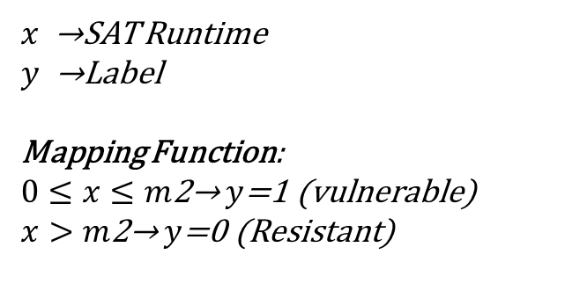
2 class distribution of circuit classification
$$m2= \frac{37730+81930}{2}=59830$$
$x$ →SAT Runtime
$y$ →Label
Mapping Function:
$0≤x≤m\text{2}\text{→}$ $y$=1 (vulnerable)
$x>m\text{2}\text{→}$ $y$=0 (Resistant)
$$m2$$
# vulnerable samples = 431
# Resistant samples = 55

